Slide 1
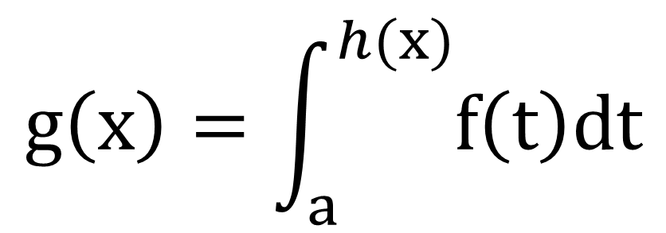
$$g\left(x\right)=\int_{a}^{h(x)}{f\left(t\right)dt}$$

